Slide 1
“Nice Shot”:
a Big Data project for analyzing NBA shot logs based on Scala
CSYE7200 Big-Data Sys Engr Team Project
Team 6
Mentor: Dr. Robin Hillyard
Teaching Assistant: Jiawei Li
Team Members: Cuican Wang, Nan Deng, Shengchen Liu and Xun Wang
Notes:
Project title with team members (and team number);

Slide 2
Final Goal
Shot location =?
Field goal percentage =?
Period =?
Model
Defender distance =?
Score margin =?

Slide 3
Project Workflow
Data Acquisition
Data Combination
Data Visualization
Data ingestion
Zone Dividing
Data Visualization
Verification
2. Statistical analysis
3. Machine learning
Data Cleaning
Feature Normalization
Model Selection & hyperparameter tuning
HTML, CSS, Ajax
JavaScript Canvas, play framework
4. Web development

Slide 4
Data Ingestion
Two data sources:
“Stats.nba.com” api :provide each player’s shot logs for all the games during 2015-16 season
“SportVU game logs” : real-time movement logs of each player for 638 games during 2015-16 season
In order to get each shot’s corresponding defender information(loc_x, loc_y, defender distance...) which will be used by our ML model afterwards, we combined data sets from these two data sources based on game_id, period and game_clock.

Slide 5
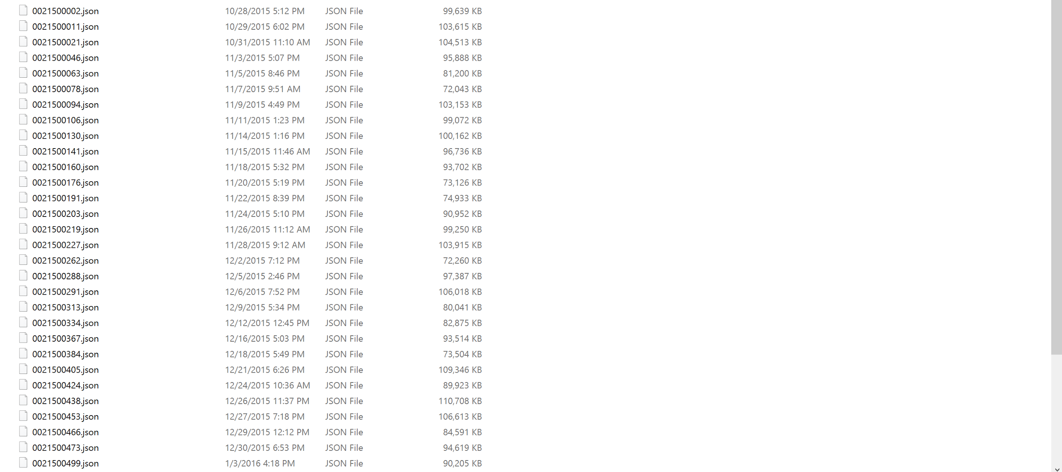
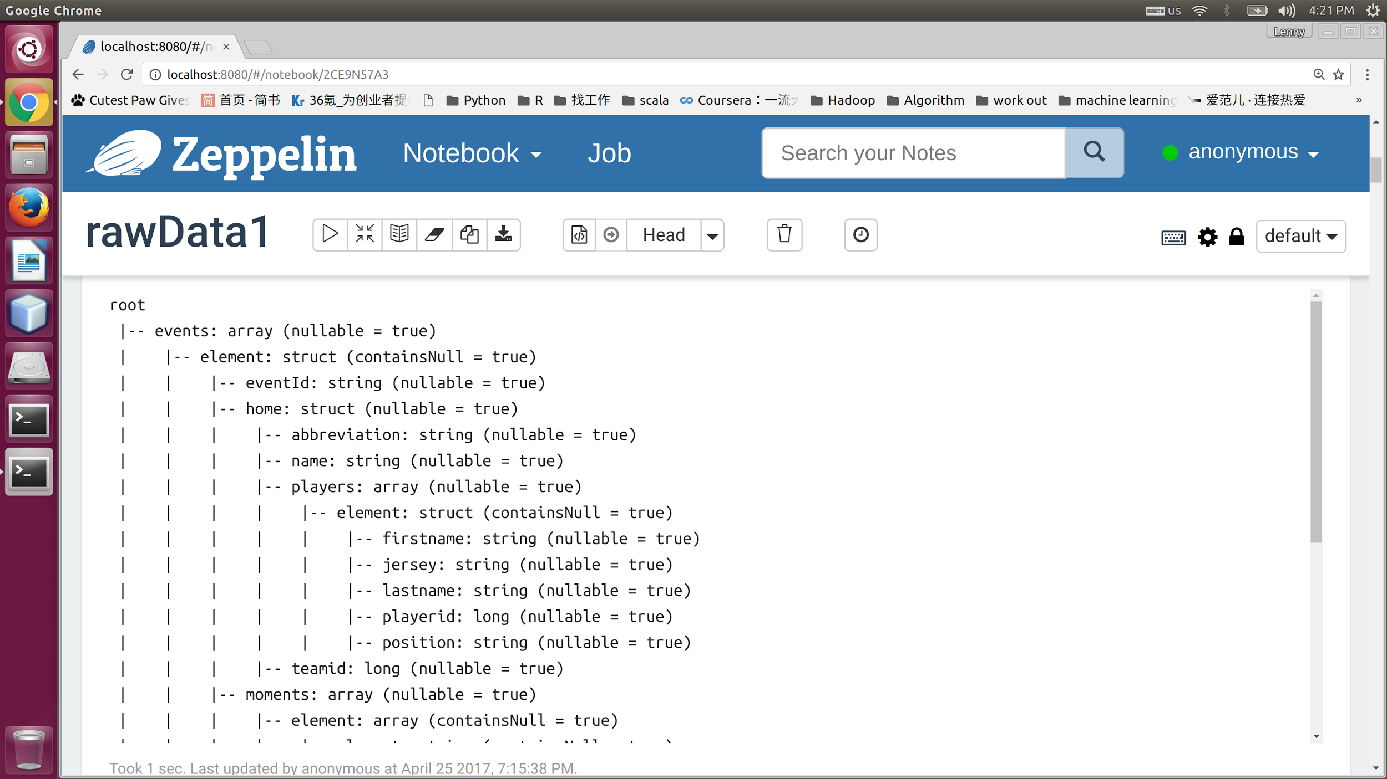
Data Ingestion
Json data from NBA.Raw.SportVU.Game.Logs
About 2,000,000 rows per file

Slide 6
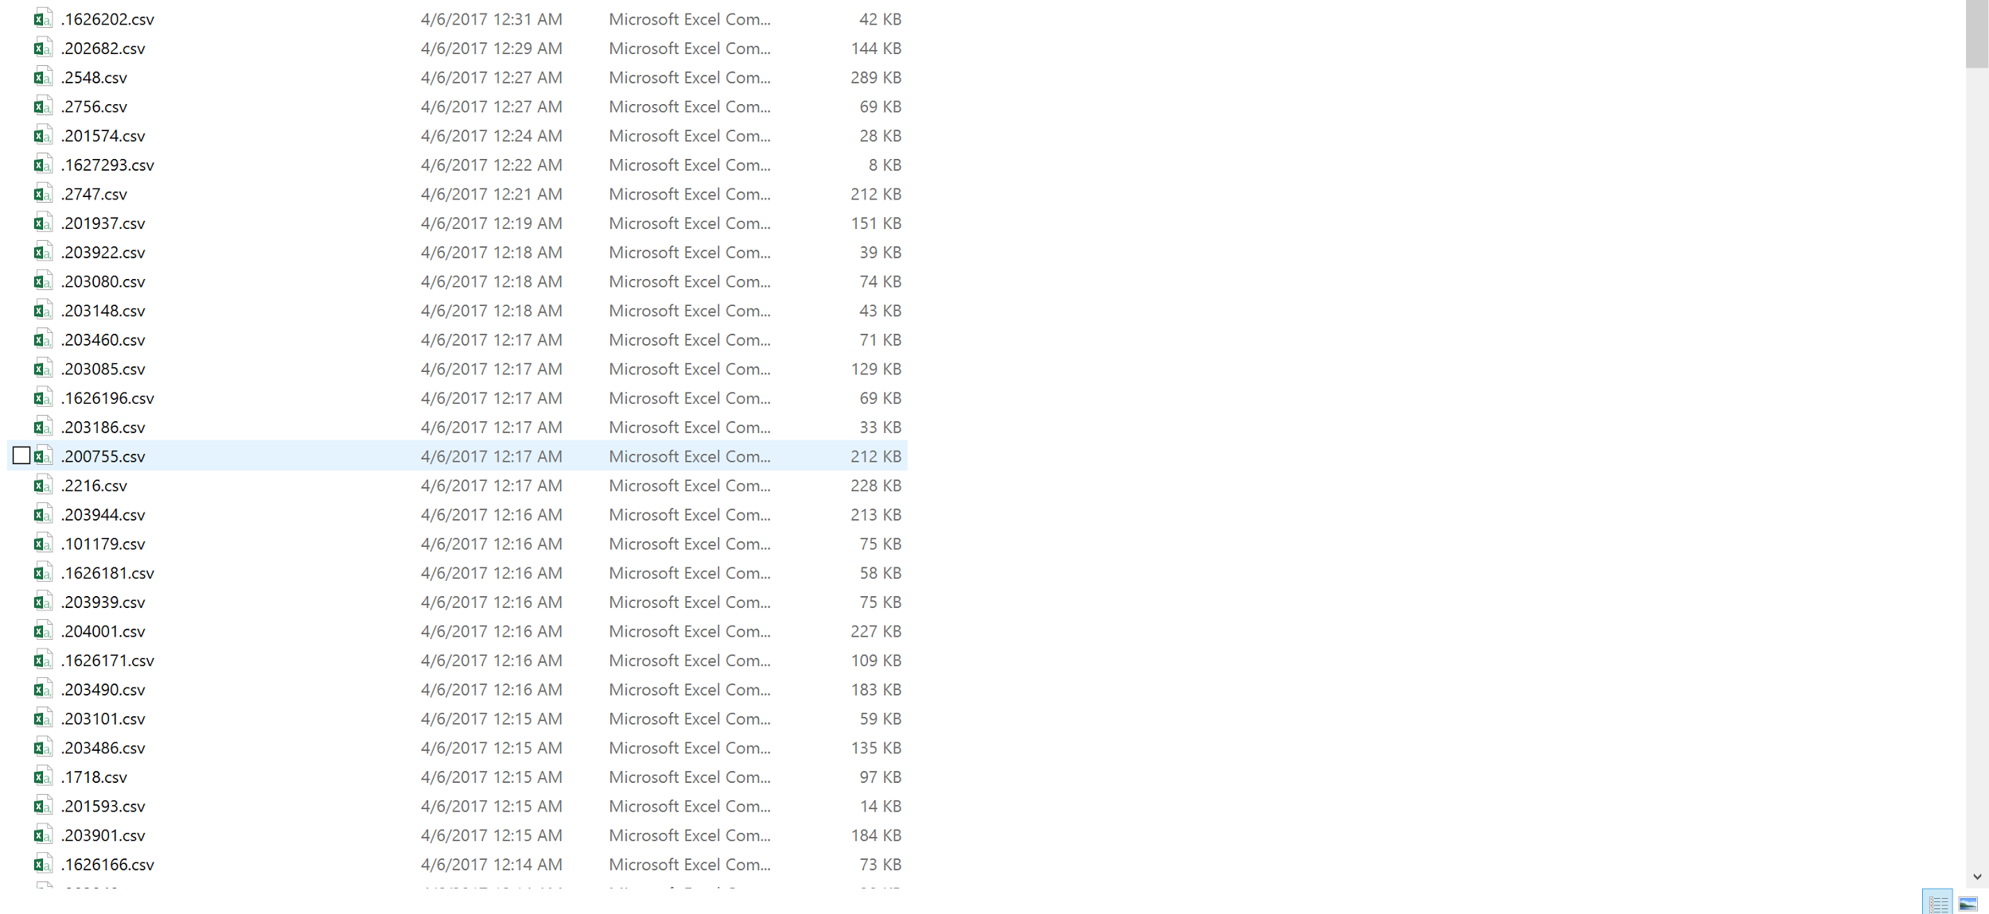
Data Ingestion
Json data from stats.nba api

Slide 7
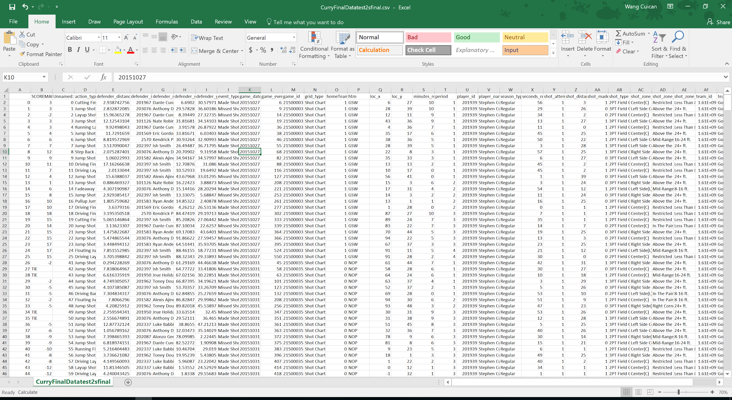
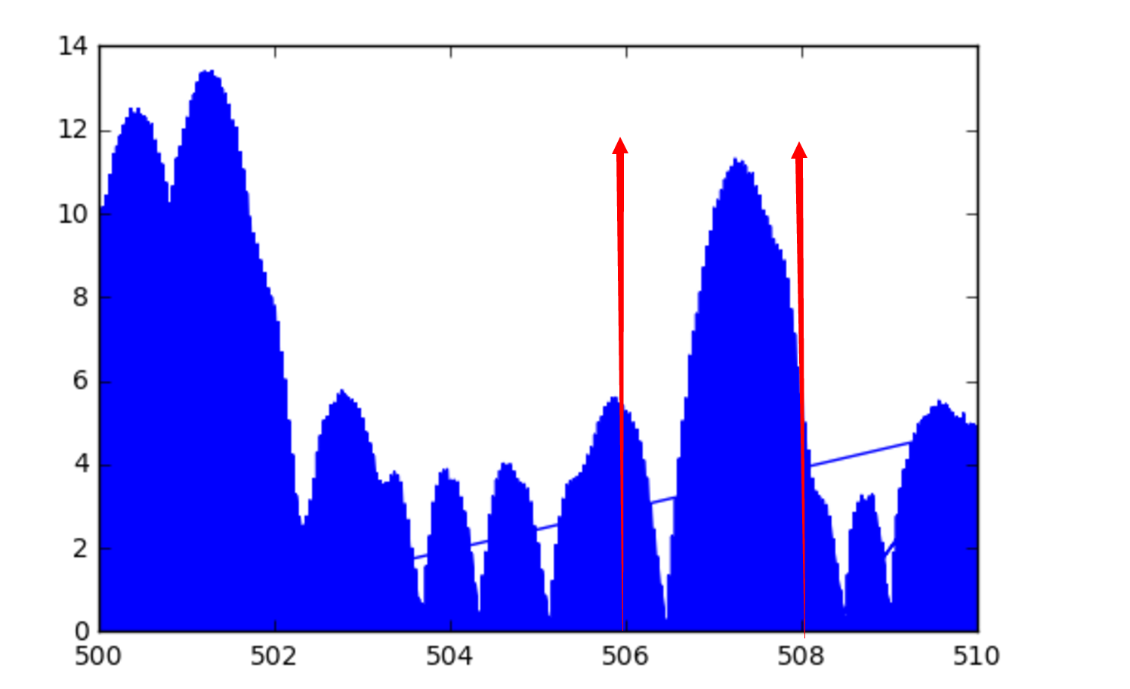
Data Ingestion
Discussion of 2s

Slide 8
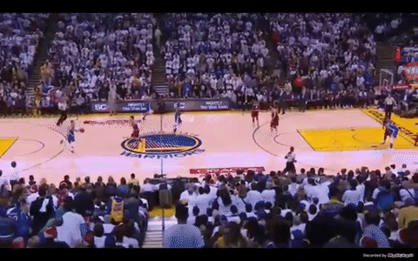
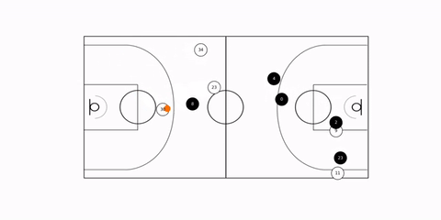
Data Ingestion
Animation visualization of NBA.Raw.SportVU.Game.Logs
(Source: https://youtu.be/2WXGZtYYgu4 )

Slide 9
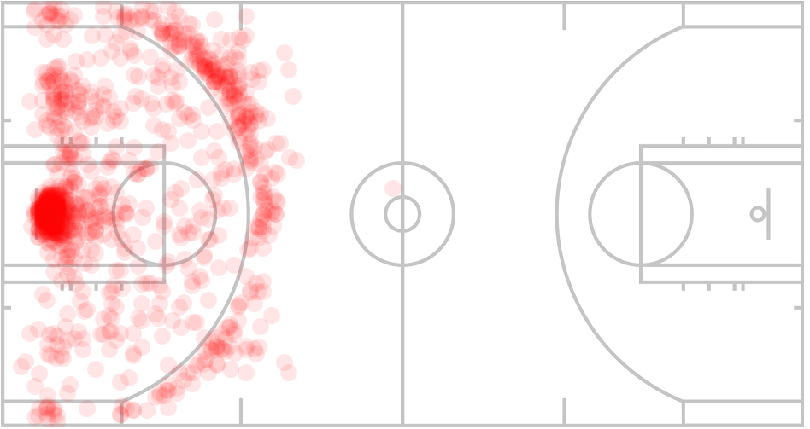
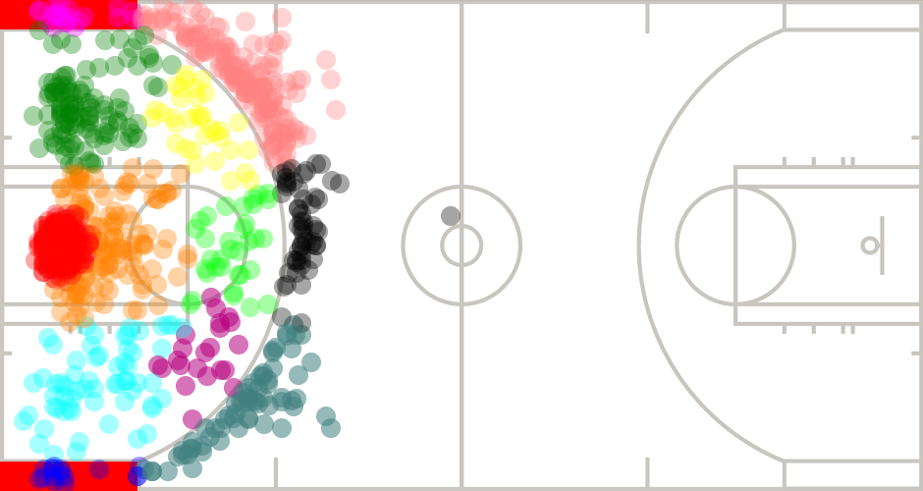
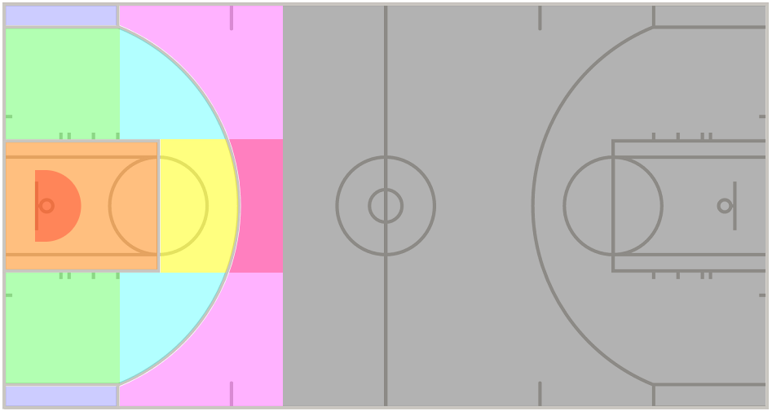
Some Observation from the Data

Slide 10
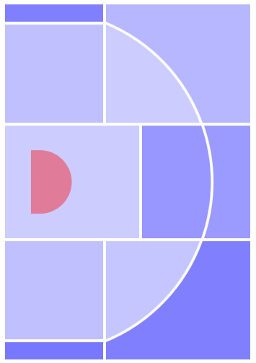
Zone-based Stats of Lebron James
Overall: 52.0% (737/1416)
Restricted Area: 69.9% (478/684)
In the Paint: 40% (54/135)
Left Mid-range: 37.7% (55/146)
Right Mid-range: 37.7% (23/61)
Center Mid-range: 30.0% (8/27)
Ctr Left Mid-range: 40% (20/50)
Ctr Right Mid-range: 38.7% (12/31)
Ctr Left 3-PT: 35.9% (47/131)
Ctr Right 3-PT: 25% (15/60)
Ctr 3-PT: 30.2% (16/53)
Left Corner: 25% (5/20)
Right Corner: 23% (4/14)

Slide 11
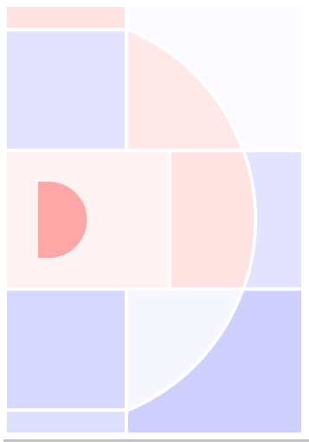
Zone-based Stats of Stephen Curry
Overall: 50.8% (396/779)
Restricted Area: 65.8% (123/187)
In the Paint: 52.5% (32/61)
Left Mid-range: 44..4% (12/27)
Right Mid-range: 42.3% (11/26)
Center Mid-range: 55.6% (5/9)
Ctr Left Mid-range: 54.5% (6/11)
Ctr Right Mid-range: 48.3% (14/29)
Ctr Left 3-PT: 49.2% (62/126)
Ctr Right 3-PT: 47.6% (60/147)
Ctr 3-PT: 44.4% (40/90)
Left Corner: 55.5% (20/36)
Right Corner: 43.5% (10/23)

Slide 12
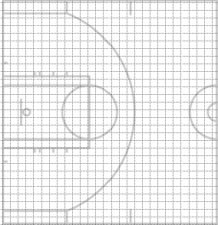
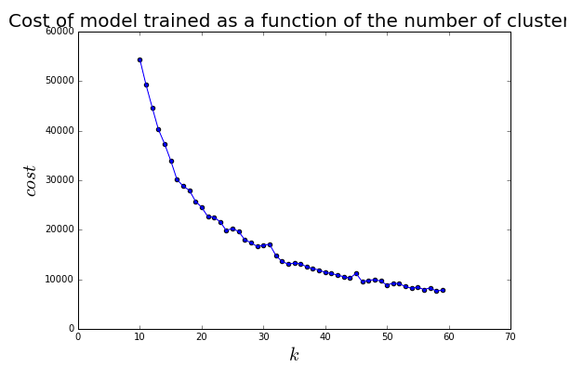
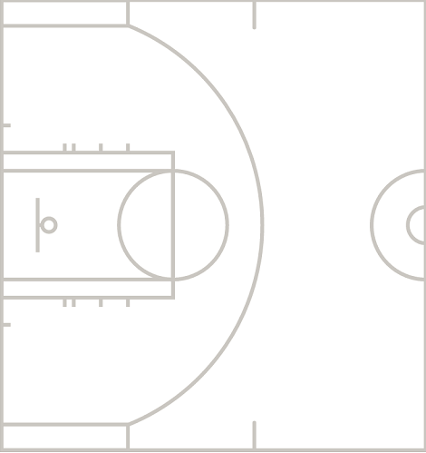
Is this the only way?

Slide 13
Machine learning
1.Read data from .csv files into Spark.sql.dataframe
2. Drop “Hail Mary” shots
3. Full court => half court
4. Data parsing: score margin, defender distance, home/ visit team
5. Dealing with categorical values. Use StringIndexer to convert String categorical values into integer indexes.

Slide 14
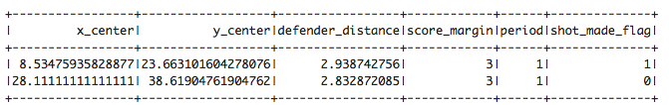
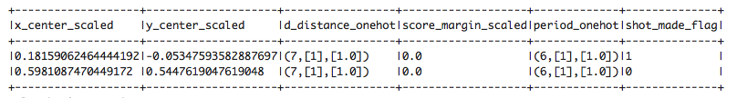
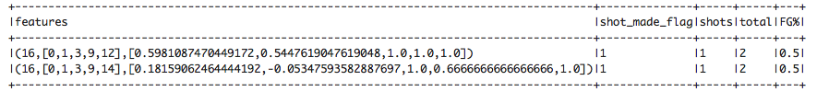
Machine learning
[0~47] (ft)
[-25~25] (ft)
(ft)
(pts)
[1~5]
Construct feature vector
Feature normalize
(Use “StandardScale”)
[0~1]
[-1~1]
Encoding the integer indices with “OneHotEncoder”
Split the data into training and test sets
Calculate shooting percentage for distinct feature vector

Slide 15
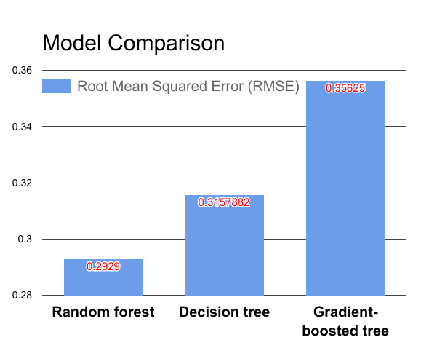
Model selection
Decision tree regression
Gradient-boosted tree regression
Random forest regression

Slide 16
Hyperparameter tuning
“Cross-Validation”:
use a ParamGridBuilder to construct a grid of parameters.(Num_tree\Max_depth)
Num_tree\ Max_depth | 15 | 20 | 25
4 | 0.28805 | 0.29819 | 0.31713
5 | 0.29949 | 0.2929 | 0.3126
6 | 0.29791 | 0.30794 | 0.318910
Notes:
We use a ParamGridBuilder to construct a grid of parameters to search over. With 3 values for hashingTF.numFeatures and 2 values for lr.regParam, // this grid will have 3 x 3 = 9 parameter settings for CrossValidator to choose from.

Slide 17
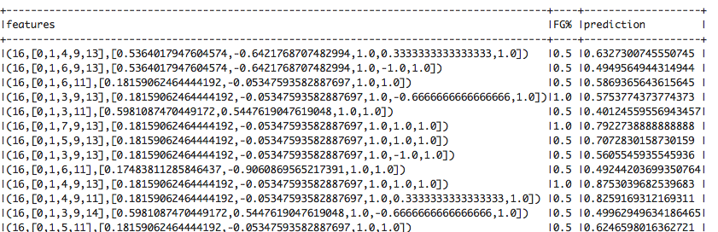
Prediction

Slide 18
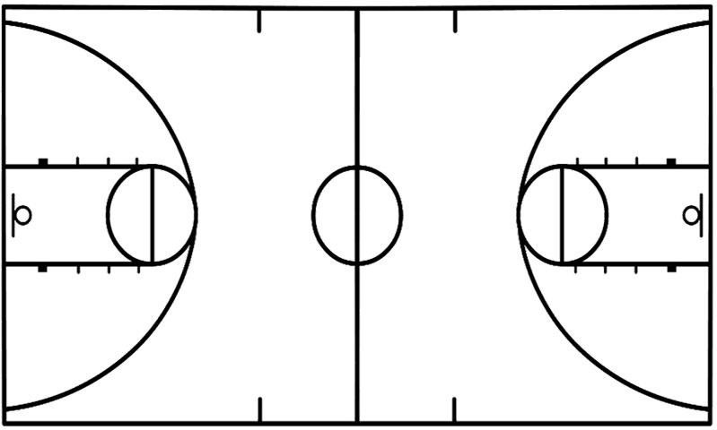
Web Development
JavaScript Canvas
Html, CSS, Ajax
Rest API
Play FrameWork

Slide 19
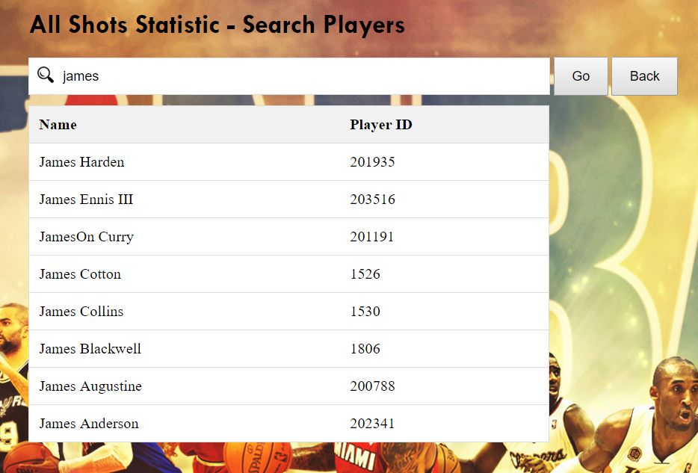
All Players Data

Slide 20
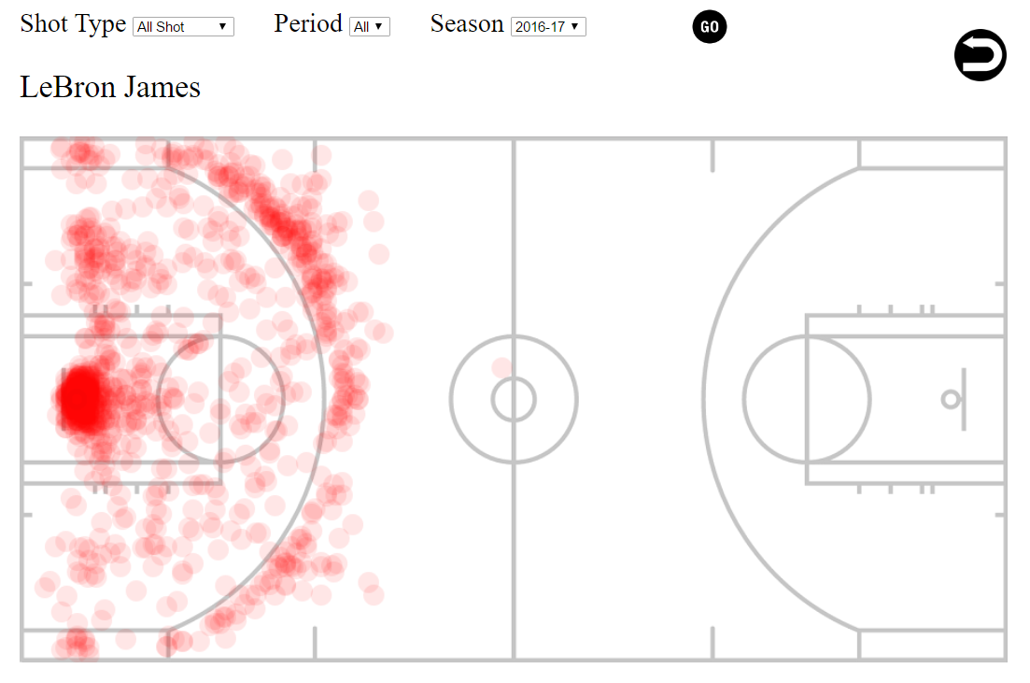
Rest API

Slide 21
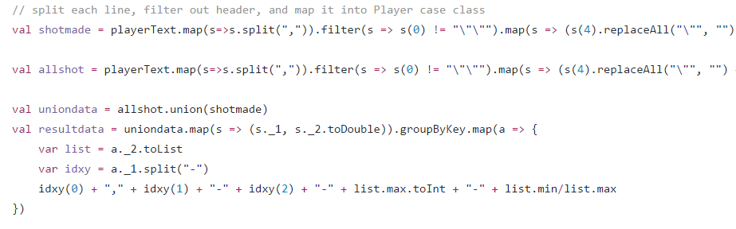
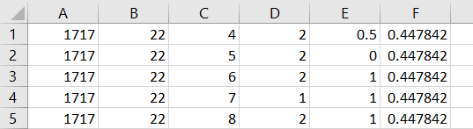
MapReduce

Slide 22
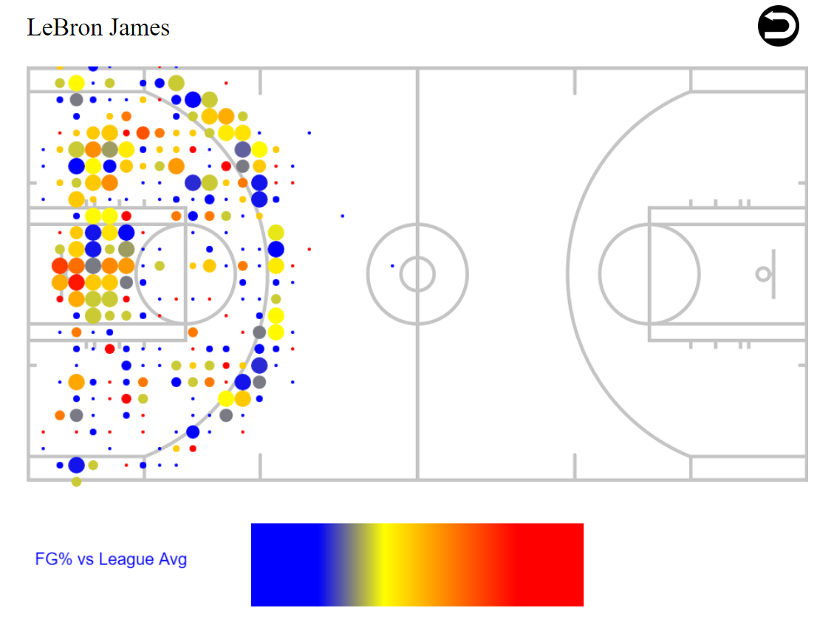
Field Goal Percentage vs League Average Percentage

Slide 23
Acceptance criteria
Predictive Analysis: split the data into training set and test set. Study it with our shooting/defending model. Root Mean Squared Error (RMSE) is less than 0.3
Unit tests are used before and after the codes are imported into Spark.
Notes:
(how will I know that you have achieved what you set out to do?).

